Slide 1



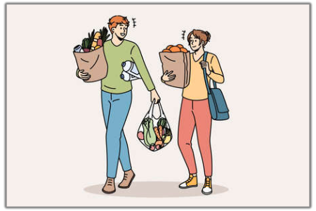
GROCERY
Almasdivan K
Ananda Dharshinee M S
Aparna Gayathri N
Dheepika R
Haripriya N

Slide 2
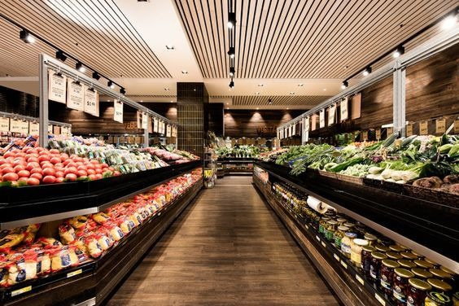
DESCRIPTION
The "Efficient Grocery Management System" is a comprehensive software solution designed to streamline and enhance the operations of grocery stores and supermarkets. In today's fast-paced world, managing a grocery store efficiently is essential to meet customer demands, optimize inventory, reduce wastage, and maximize profitability. This project aims to address these challenges by providing a user-friendly and feature-rich platform for grocery store management.

Slide 3
Features
Create an account, login or logout
Browse available products added by the admin
Add products to the shopping cart
Delete products from the shopping cart
Display the shopping cart
To checkout, a user must be logged in
Checkout information is processed using stripe and the payment is send to the admin
The profile contains all the orders a user has made

Slide 4
Project Requirements
Frontend
React.js
Bootstrap version 4.4.1
FontAwesome version 5.13.0
Backend
Node.js version 12.16.3
MongoDB version 4.2.0
Express version 4.16.1
Passport: used for authentication
Express Validator: used for form validation

Slide 5
Thank you!

